Slide 1
Implementation Problems and Solutions in Stochastic Volatility Models of the Heston Type
Jia-Hau Guo and Mao-Wei Hung

Slide 2



The Discontinuity Problem
The complex logarithm contained in the formula of the Heston model is the primary problem.
The logarithm of a complex variable is multi-value.
If one restricts the logarithm to its principal branch (similar to most software packages, such as C++, Gauss, Mathematica, and others), it is necessarily discontinuous at the cut (see Figure 1).

Slide 3
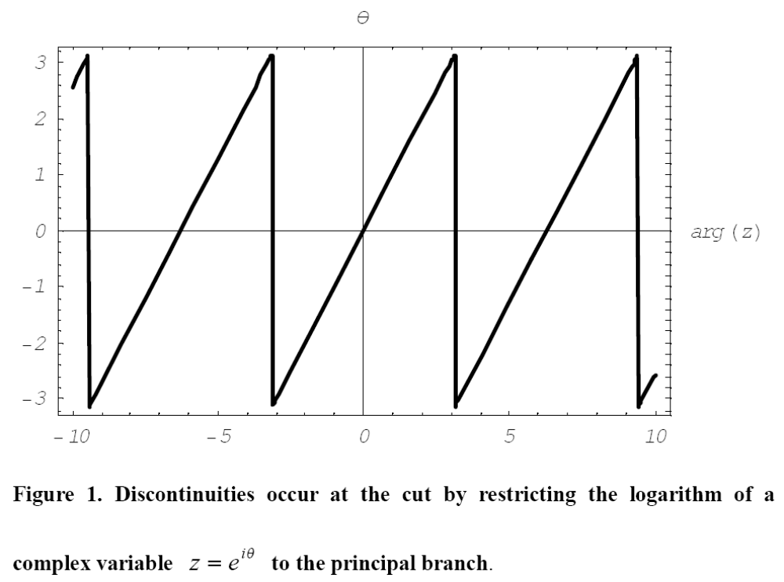

Slide 4
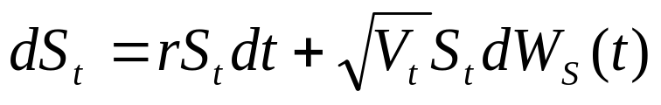
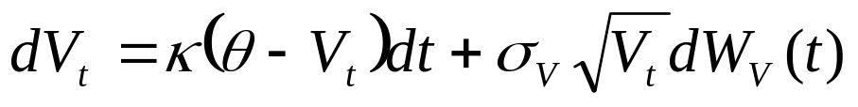
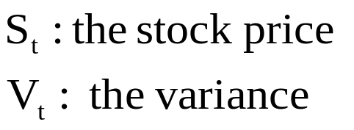
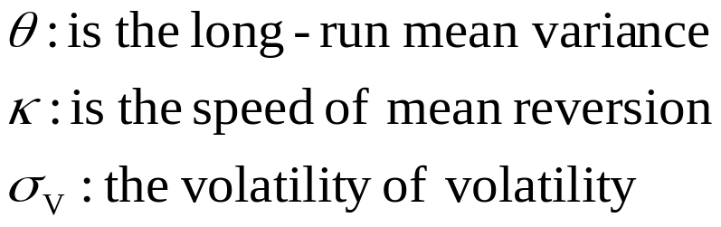

Heston’s stochastic volatility model
(1)
(2)

Slide 5
Lewis’ illustration
The Heston model is represented in the transform-based solution
The type of financial claim is entirely decoupled from the calculation of the Green function
Different payoffs are then managed through elementary contour integration over functions and contours that depend on the payoff
The issue is fundamentally related to the Green function component of the solution

Slide 6




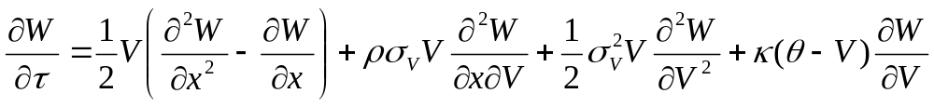
The Transform-based Solution
The Heston partial differential equation for a European-style claim
(3)
Reduce (3) from two variables to one and entirely separate every (volatility independent) payoff function from the calculation of the Green function.
(4)

Slide 7

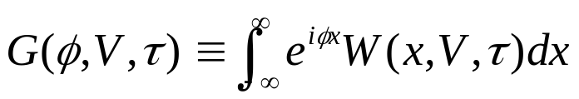
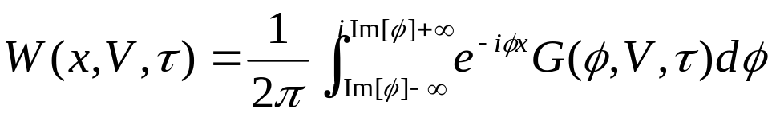
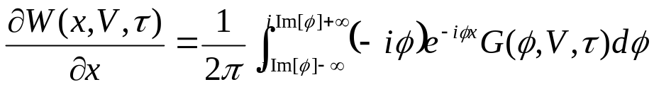
Define the Fourier transform of
(5)
The inversion formula is
(6)

Slide 8


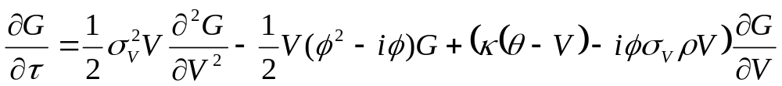


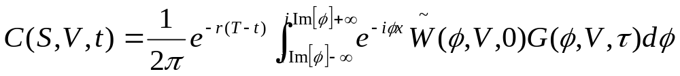

The Fundamental Transform
Taking the derivative of both sides of (5), and then replacing inside the integral by the right-hand side of (4),
(7)
A solution to (7), which satisfies , is called a fundamental transform.
Given the fundamental transform, a solution for a particular payoff can be obtained by
(8)
is the Fourier transform of the payoff function at maturity.

Slide 9




The Payoff Function of a Call Option
At maturity, the payoff of a vanilla call option with strike is
In terms of the logarithmic variables, we have
The Fourier transform of the payoff is
(9)
(9) does not exist unless

Slide 10









Other Common Types of
Payoff Functions and Restrictions
Payoff Transform Payoff Restriction
Put Option:
Digital Call:
Cash-secured Put:

Slide 11




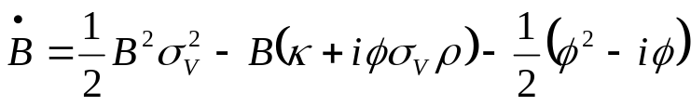
The Fundamental Solution
The fundamental solution of (7) is in the form
(10)
After substituting (10) into (7), a pair of ordinary differential equations
for and is obtained
(11)
(12)

Slide 12
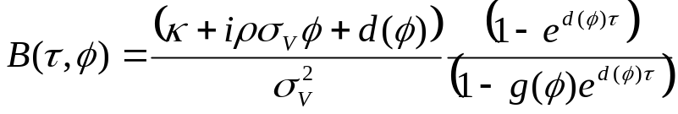
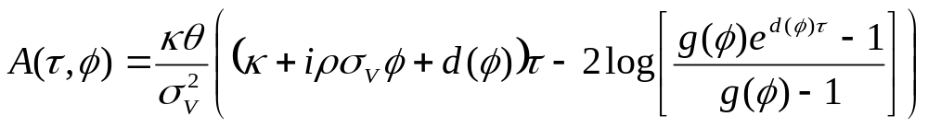
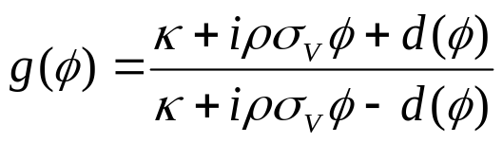
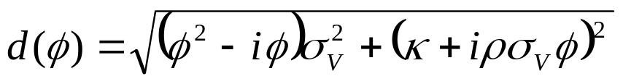
The solutions can be expressed by
(13)
(14)
The auxiliary functions
(15)

Slide 13
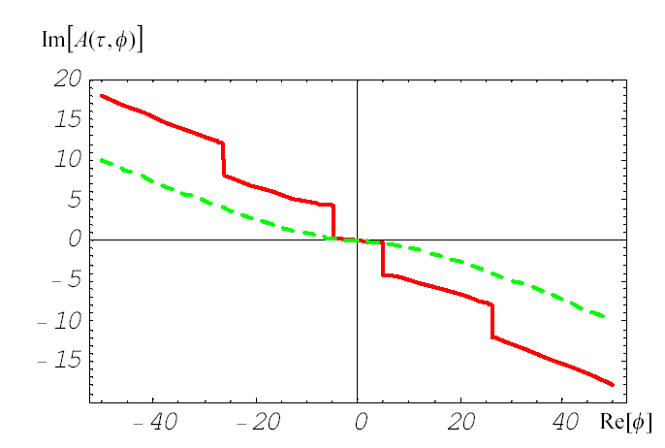
The Discontinuity Problem in the Formula
Figure 2 illustrates the discontinuity problem in the implementation of the fundamental solution.

Slide 14

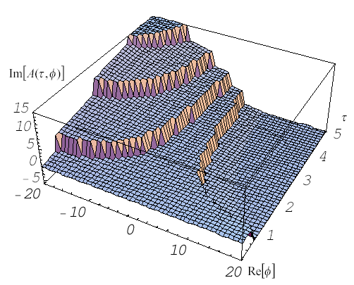
In fact, in examples with long maturity periods, discontinuities are certain to arise from the formula if the complex logarithm uses the principal branch only and is not an integer (see Figure 3).

Slide 15
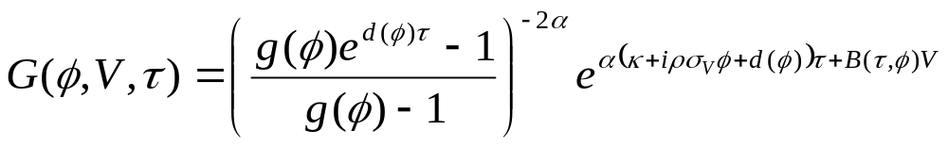







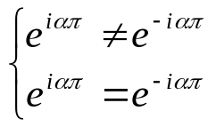

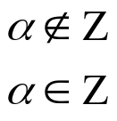


One may shift the problem from the complex logarithm to the evaluation of
(16)
where
However, discontinuities do not diminish in this way. Note that taking a complex variable to the power gives
(17)
After restricting , the complex plane is cut along the negative real axis. Whenever crosses the negative real axis, the sign of its phase changes from to .
(18)

Slide 16
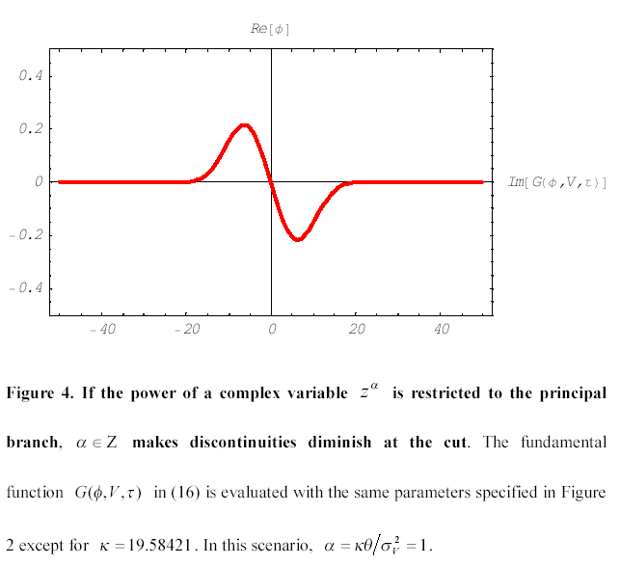

Slide 17
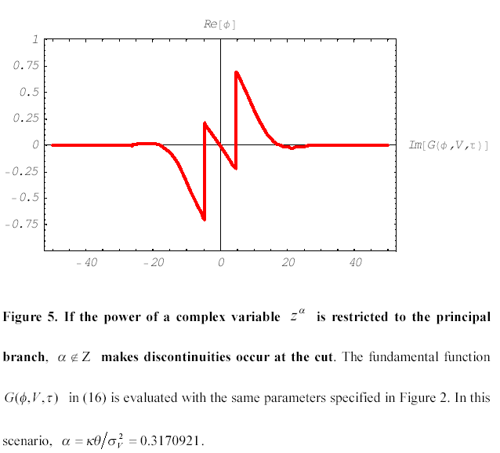

Slide 18
Solutions to the Discontinuity Problem of Heston’s Formula
Broadie and Kaya [2004] considered the simulation as a practical alternative for finding option prices.
Kruse and Nögel [2005] tracked the complex logarithm function for each step along a discretised integral path to remedy phase jumps.
Kahl and Jäckel [2005] remedied these discontinuities using the rotation-corrected angle of the phase of a complex variable.
Shaw [2006] dealt with this problem by replacing the call to the complex logarithm by direct integration of the differential equation.
Guo and Hung [2007] proposed a simple adjusted formula to solve this discontinuity problem.

Slide 19




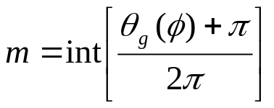


Rotation-Corrected Angle
In order to guarantee the continuity of , an rotation-corrected term must be additionally calculated in advance. First, we introduce the notation
(19)
(20)
The next step is to have a closer look at
(21)
where
(22)
(23)
(24)

Slide 20

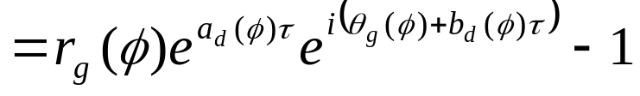
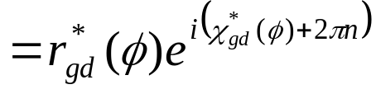
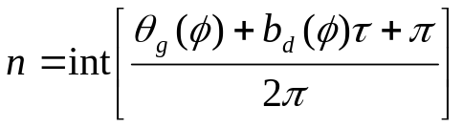



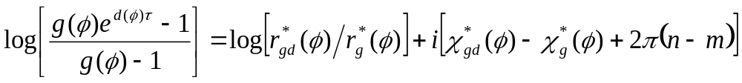

The same calculation is done with
(25)
where
(26)
(27)
(28)
Hence, we can compute the logarithm of quite simply as
(29)
where is the rotation-corrected angle.

Slide 21
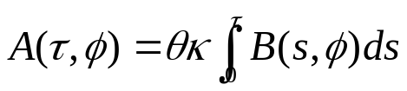
Direct Integration
Another way to avoid the branch cut difficulties arising from the choice of the branch of the complex logarithm is to perform direct numerical integration of
w.r.t. according to (11). Given , can be obtained by
(30)
After replacing the call to the complex logarithm by direct integration of the differential equation, the complex logarithm can not be a problem any more and the continuity of is guaranteed.

Slide 22

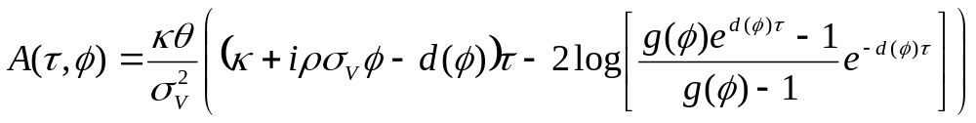



Simple Adjusted Formula
The solution is to move into the logarithm of by simply adjusting as follows:
(31)
Because an imaginary component must be added to move a complex number across the negative real axis, the phases of and exist on the same phase interval.
Therefore, the logarithms of and have the same rotation count number.

Slide 23
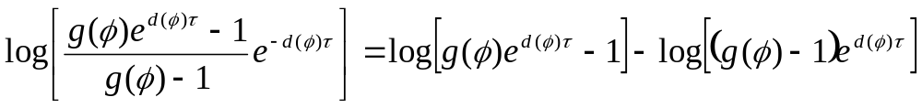



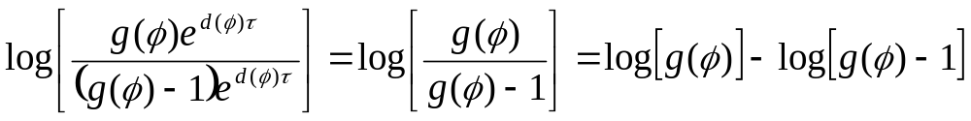


Obviously,
(32)
Because the subtraction of 1 does not affect the rotation count of the phase of a complex variable, has the same rotation count number as
Nevertheless, needs no rotation-corrected terms for all levels of Heston parameters because
(33)
And, again, and has the same rotation count number.
Hence, the formula in (31), for , provides a simple solution to the discontinuity problem for Heston’s stochastic volatility model.

Slide 24
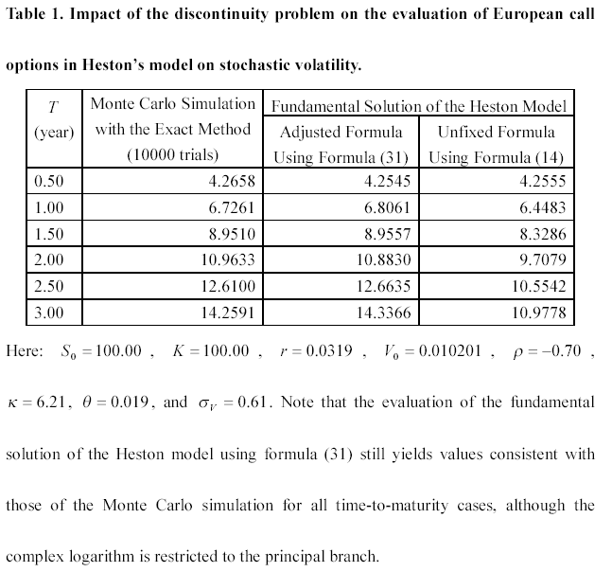

Slide 25
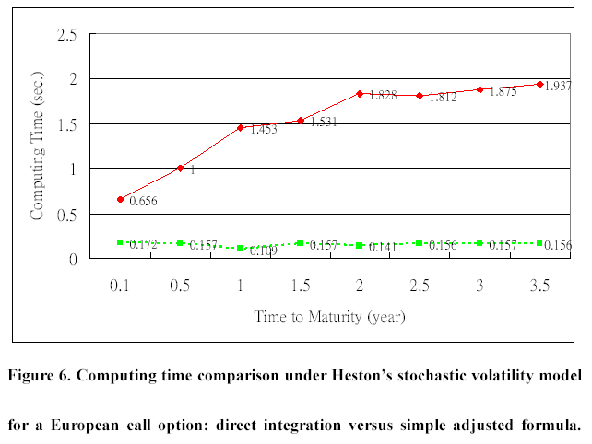

Slide 26
Conclusions
Compared to the rotation-corrected angle method, the simple adjusted-formula method needs no rotation-corrected terms in the already complex integral of Heston’s formula to recover its continuity for all levels of Heston parameters.
Although the direct integration method neither needs the rotation-corrected terms to guarantee the continuity of Heston’s formula, it inevitably introduces the discretization bias into the evaluation of the Green function component of the solution.
Many steps may be necessary to reduce the bias to an acceptable level and, hence, more computational effort is needed to guarantee that the bias is small enough.
As a consequence, the direct integration method requires much more computing time than the simple adjusted-formula method.

